Slide 1


SUPERHERO U
What?
Competitive Event
When?
Deadline to
defeat the villains
How?
Video
Comic Strip
Presentation
Who?
Students
Team of 4

Slide 2

SUPERHERO U
Motive
Innovation
Inventiveness
creativity
Themes
5 P’s
Inspirations
UN Global Compact
UN Women
UN Sustainable Development
“Superhero”
Defeat real world problems

Slide 3

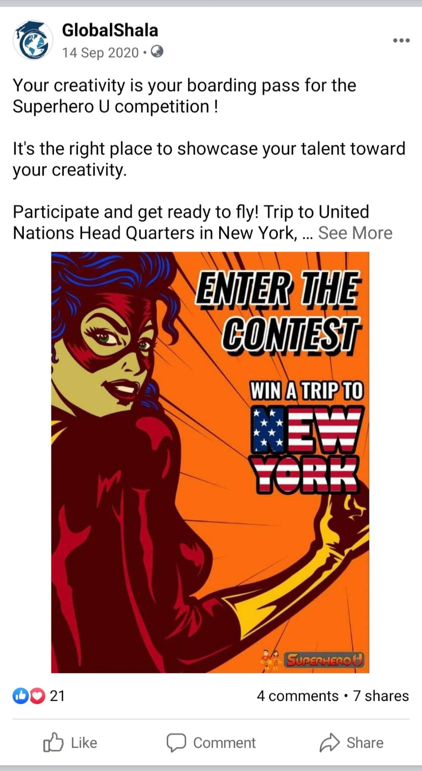

1
2
3
4

